Slide 1

Case Study
Successes & Challenges in Exports to Africa
KZN Export Week 29 October 2015

Slide 2



Brief Background
Family business established in 1962
The company manufactures personal care products under its own brands and also a limited amount of Private Label
The company distributes via major retail stores, pharmacies & independents in South Africa and exports to 17 countries throughout the world
Enquiries from Africa have increased and this has become a strategic focus for the business

Slide 3
Focus on Africa – Challenges
Sales - our brands are unknown
  Known brands are sought after ,
  as are products from USA & UK
  SA status is mixed
Market - categories we operate in are mainly undeveloped
  Potential unknown
  Gamble for importers / distributors

Slide 4
Focus on Africa – Challenges
Distribution - Finding the “Right Fit” with Importer
  Big - able to pay , good distribution, demanding of marketing support & your business doesn’t get priority
  Small - value opportunity , prepared to build brand, limited resources and distribution, struggle to pay
Payment
  Upfront ideal but difficult
  Forex availability
  Exchange rate

Slide 5
Focus on Africa – Challenges
Where to start :
What countries ?
  Language
  Regulatory requirements
  Potential
What trade channels ?
  Majority of volume is done via independents & open markets
  Fragmented & difficult to engage
  Not brand building

Slide 6
Focus on Africa – Challenges
Highly Regulated with poor compliance & corruption
  Differing requirements hard to meet
  Difficult to compete ;
    duties & grey imports
    False product promise
    Product performance
    Fake s
Pricing ;
  Product dumping
  Indian & Chinese - low cost producers
Consumer education & awareness
  Well know brands provide assurance of quality
  Quick results

Slide 7
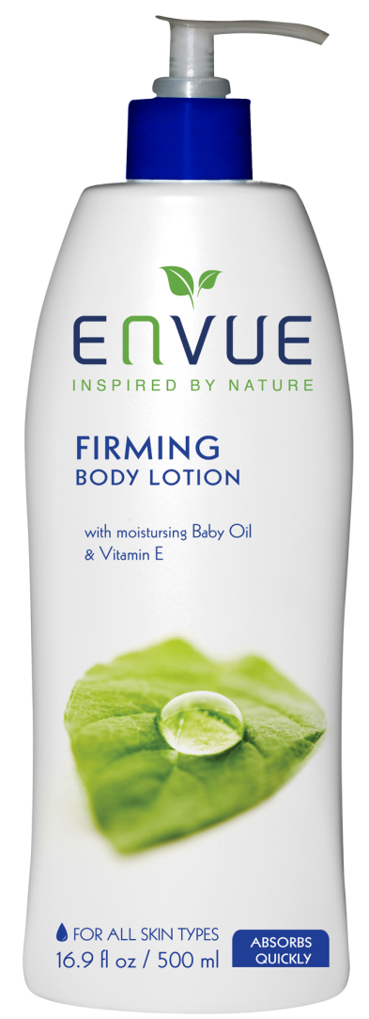



Strategy to Develop Business in Africa
Challenge – Brands are Unknown
Strategy - offer Private Label

Slide 8
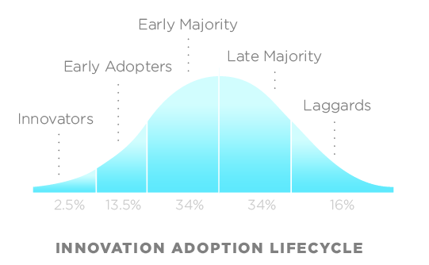
Strategy to Develop Business in Africa
Challenge – Brands are Unknown
Strategy ;
  In developing categories accept it will take time , persist & support development of brands
  In well known categories find way to differentiate ourselves
2.5%
13.5%
34%
34%
16%
Developing
Differentiate

Slide 9
Strategy to Develop Business in Africa
Challenge – Categories are Unknown
Strategy - R&D
  Proactive re-alignment of product offering
  Dedicated resource
  Ideally product sells in SA & Africa
South Africa
Africa

Slide 10


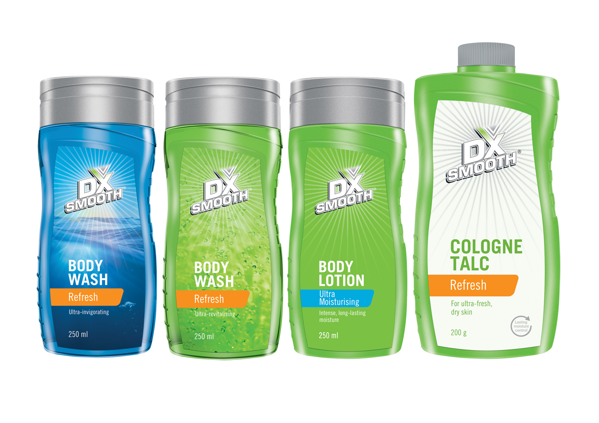

Slide 11
Strategy to Develop Business in Africa
Challenge – Where to Start
Strategy
  Make use of formal SA retailers who have distribution in Africa - Shoprite, Game, Pick n Pay, Spar
  Make use of independents who are active in Africa or who attract African customers
  Decide on markets where we will active entry & others where we will be reactive
  Focus on low hanging fruit - SADC easier
  Focus on established supply line / hubs - London / Dubai

Slide 12
Strategy to Develop Business in Africa
Challenge – Highly Regulated with poor compliance & corruption
Strategy
  Ensure we meet all regulatory product requirements
  Sell ex-works
  Leave importers to take care of logistics

Slide 13
Strategy to Develop Business in Africa
Challenge – Pricing
Strategy
  Focus on new & specialist categories where we can establish our brands as front runners
  Focus on upper end / premium offering

Slide 14
Strategy to Develop Business in Africa
High Income
Our area of success
Mass
Niche
`
Low Income

Slide 15
Strategy to Develop Business in Africa
Advanced
Intermediate
Basic
Higher income , modern ,well educated ,mainly urban
Middle income ,educated, urban and rural
Lower income ,traditional ,
Uneducated, rural

Slide 16


Slide 17
Africa – Successes
Sales directly into the following countries ;
  Nigeria
  Zambia
  Zimbabwe
  Kenya
Sales via SA retailers in stores throughout Africa
Many good enquiries & prospects in the pipeline
Sales remain small but are growing – 206% versus previous year

Slide 18
thank you

