Slide 1
Welcome to Hungary

Slide 2
Welcome to Hungary

Slide 3
Welcome to Hungary

Slide 4
Welcome to Hungary

Slide 5
Welcome to Hungary

Slide 6
Welcome to Hungary

Slide 7
Welcome to Hungary

Slide 8
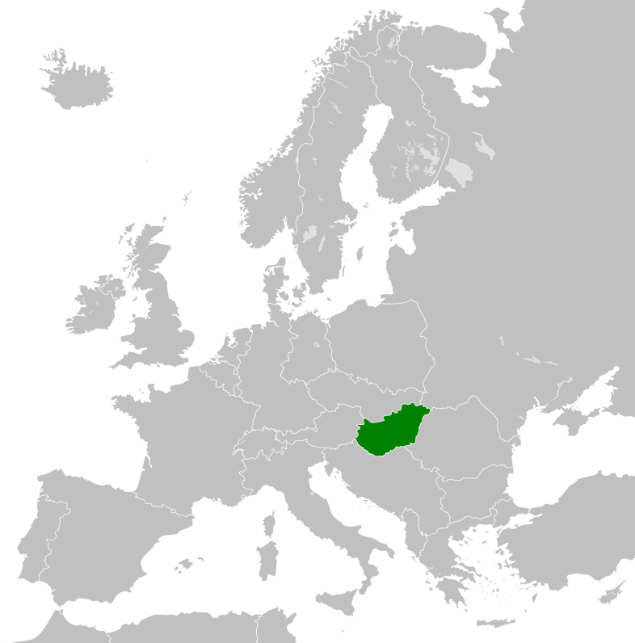

Slide 10
Land 1/13
Population 1/5
GDP 1/3
GDP per capita 2/1
Salary USD 880
Unemployment 7.7%
Inflation -0.2%
Export +8.3%
Budget deficit -2.6%

Slide 16
Hungarian investment environment
THOR Laboratories
THOR Research & Development
Fitorex Ltd.
DRON használt gumi
Érd Centrum Compower
Elmat alga
Goodwill Pharma
G5 Infrastructure Developments
SECFONE SOUTH AFRICA
Invested USDm2.8 in South Africa
Invested USDm200 in Hungary

Slide 17
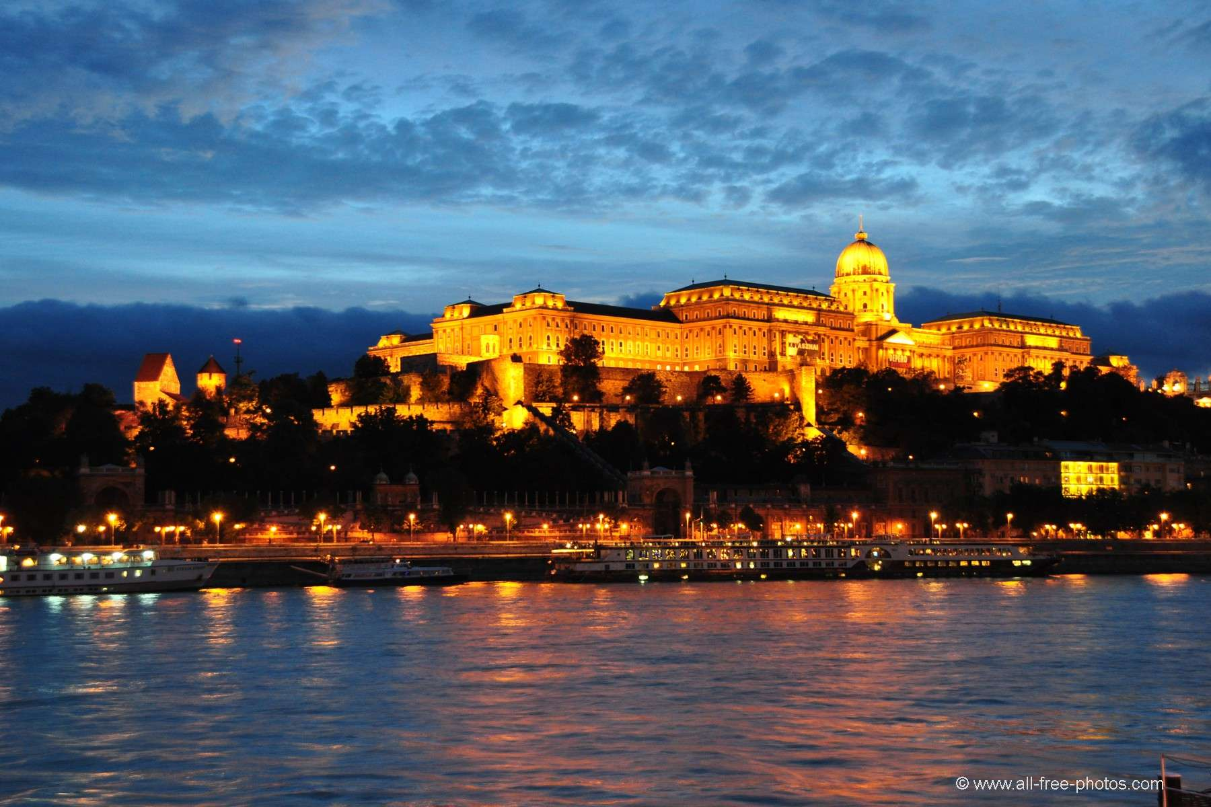
Why to invest in Hungary?
6th most cost-effective region
3rd highest road density
strategic position in the heart of the continent
highly developed telecommunications system

Slide 18
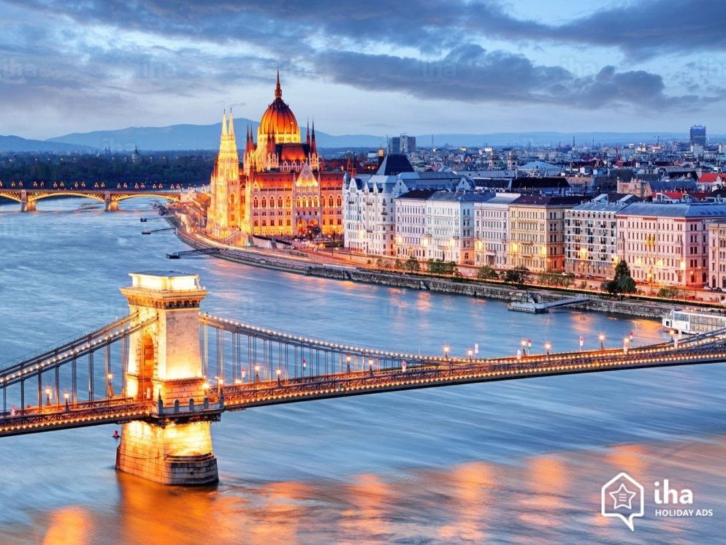
Why to invest in Hungary?
Partnership with potential investors
Very low corporate income tax rate
Well developed international banking system
Super-fast Company foundation

Slide 19
Join us and have fun in business you do

