Slide 1
KwaZulu-Natal
The Premier Trade and Investment Destination
Agriculture Export Information Sharing
27 – 28 March 2014

Slide 2
AGENDA
KWAZULU-NATAL THE TRADE HUB OF THE COUNTRY
TRADE AND INVESTMENT KWAZULU-NATAL
ROLE OF TRADE DEVELOPMENT & PROMOTION
TRADE DEVELOPMENT & PROMOTION ACTIVITIES
TRADE TRENDS AND STATISTICS
TRADE PROMOTION CALENDAR

Slide 3
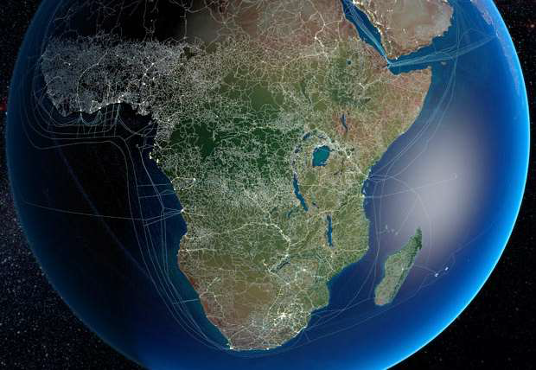
TRADE HUB OF SOUTH AFRICA
54 Countries on the African continent 39 surrounding islands
31 000 km of Coastline
71 Commercial Ports
More than 90% of world trade via sea
Only 12% inter regional trade in Africa
Shortest Trade Route between Shangai (China) and Santos (Brazil) is
via South Africa 11,270nm = 22 days @ 21 knots
via Panama Canal13,130nm = 26 days + transit fee
via Suez Canal 13,590nm = 27 days + transit fee

Slide 4
EXPORT INFRASTRUCTURE
Durban
Largest & Busiest Seaport in SA
2.6 m TEU’s p.a. - 64% exports
4 556 vessels (35%)
Upgrade - 4.5m TEU’s 2017
Houses South Africa's largest Car Terminal
Dube TradePort
World Class Air Logistics Platform
2040 Hectares developed over 60 yrs
Dube City – 12 hectare site increasing to 24 hectares on completion
Agri-Zone - 64 hectares
Cyber-Zone
Richards Bay
SA Premier Bulk Port – 82.6 metric tonnes
Africa’s largest Coal Terminal - 91 million tonnes per annum
Home the one of SA’s Industrial Development Zones

Slide 6
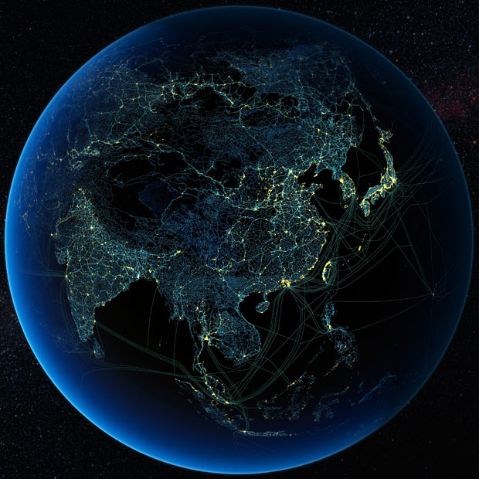
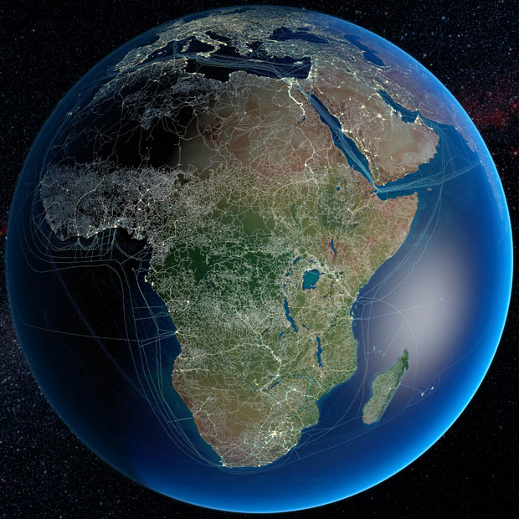
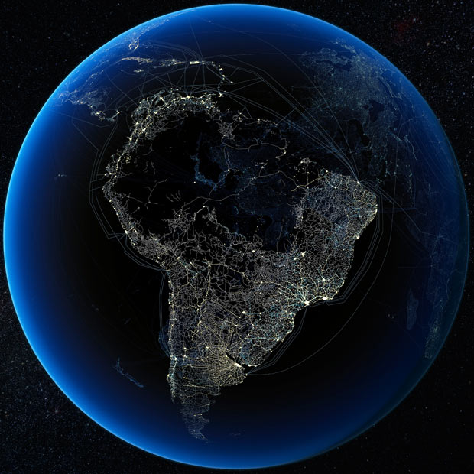
Southern Hub for World Shipping Routes
The position of South Africa’s ports system enables it to access to South-South trade, Far East trade, Europe & USA, East & West Africa regional trade
Shortest Trade Route between Shanghai and Santos is via South Africa 11,270nm = 22 days @ 21 knots
via Panama Canal13,130nm = 26 days + transit fee
via Suez Canal 13,590nm = 27 days + transit fee

Slide 7
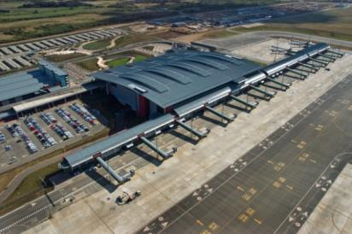
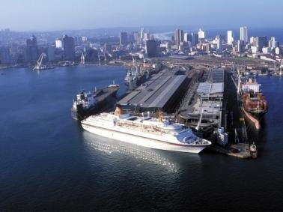
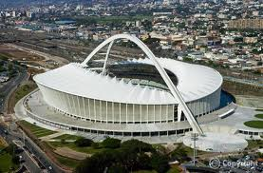
The Official Trade and Investment Promotion Agency
of the Provincial Government

Slide 8
TIKZN OPERATIONAL UNITS
TIKZN
Investment Promotion
Business Retention and Expansion
Corporate Services
Knowledge Management
Export Development and Promotion
Marketing and Communications

Slide 9
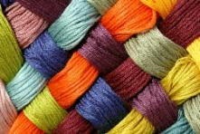
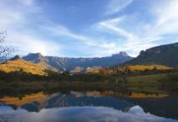
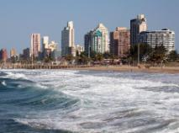
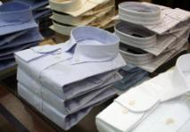
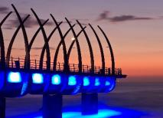
Role of Trade Development & Promotion
Exporter Development
Market Development
Information and Trade Intelligence
Assistance wıth Incentives
Coordinatıon of Trade Shows
Capacity Buildıng for Exporters
Export Awarness

Slide 10
EXPORT FACTS

Slide 11
Value of KwaZulu-Natal exports[Source: Mthente, 2013 using Quantec data]

Slide 12
KwaZulu-Natal exports by sector, 2011 [Source: Mthente 2013 using Quantec data]

Slide 13
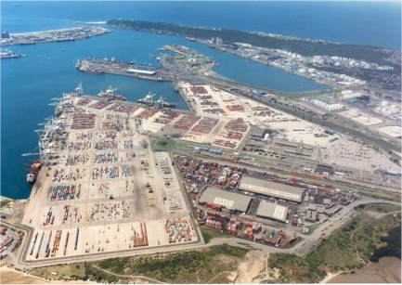
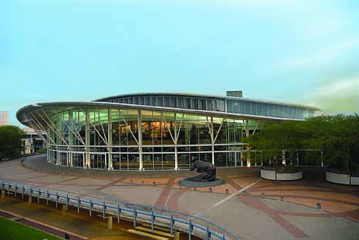
Export Products from KZN
Automotive parts and components
Sugar, prepared foodstuffs and beverages
Chemicals and Plastics
Furniture, arts & craft
Pulp & paper
Engineering services
Electronic, communication devices
Leisure boats, transport and logistics equipment
Machinery
Jewellery, base metals
Clothing, textile, body armor
Notes:
Automotive parts and components (Toyota, Motherson Sumi etc)
Sugar, prepared foodstuffs and beverages (Tongaat, Ilovo, Unilever)
Chemicals and Plastics (Sapref, Engin,
Furniture, arts & craft
Pulp & paper (Mondi. Sappi)
Engineering services (Elgin,
Electronic, communication devices (Altech UEC)
Leisure boats, transport and logistics equipment (Grinrod)
Machinery
Jewellery, base metals
Clothing, textile, body armor

Slide 14
KwaZulu-Natal product groups and contribution to exports
Product group | Value of exports (2011) | Average annual growth rate 2006-2011 | Value of exports (2012) | Average annual growth rate 2006-2012
Metals (H72-83) | R29.8 Billion | 19.1% | R29.2 Billion | 15.4%
Transport equipment (H86-89 & 98) | R12.9 Billion | 11.0% | R15.4 Billion | 14.1%
Mineral products (H25-27) | R12.1 Billion | 19.2% | R17.2 Billion | 29.9%
Chemical & allied industries (H28-38) | R7.0 Billion | 19.5% | R15.4 Billion | 14.1%
Wood, paper & pulp (H44-49) | R5.0 Billion | -5.6% | R4.4 Billion | -6.0%
Machinery/electrical (H84-85) | R4.4 Billion | 2.2% | R5.0 Billion | 4.5%
Vegetable products and fats (H6-15) | R1.5 Billion | 54.5% | R6.3 Billion | 13.5%
Plastics/rubbers (H39-40) | R1.4 Billion | 12.5% | R1.5 Billion | 12.8%
Prepared foodstuffs (H16-24) | R1.2 Billion | -12.2% | R1.7 Billion | -7.1%
Textiles (H50-63) | R825.3 Million | -3.3% | R906 Million | -1.4%
Misc manufactured articles (H90-97) | R813.6 Million | 17.8% | R559 Million | 5.0%
Animals & animal products (H1-5) | R144.7 Million | 35.6% | R174 Million | 39.1%
Footgear and headgear (H64-67) | R104.9 Million | 2.2% | R126 Million | 5.7%
Stone/glass (H68-71) | R72.8 Million | -15.6% | R143 Million | -9.5%
Hides, skins, leather & fur (H41-43) | R69.1 Million | 15.7% | R96 Million | 25.1%
Other unclassified goods and services (H99) | R4.3 Million | -2.7% | R116 Million | 376.7%
[Source: Mthente 2013, using Quantec data]

Slide 15
KwaZulu-Natal’s top 15 export markets
Country (ranking in 2006) | Value of exports (2011) | Share of total value of exports | Average annual growth rate 2006-2011 | Top export product (HS 4-digit)
US (1) | R6.4 Billion | 8.2% | 0.0% | Titanium ores and concentrates (H2614)
Japan (2) | R5.2 Billion | 6.7% | 0.7% | Unwrought aluminium (H7601)
China (8) | R4.7 Billion | 6.1% | 60.4% | Niobium tantalum vanadium zirconium ores, concentrates (H2615)
UK (3) | R3.7 Billion | 4.8% | -2.4% | Motor vehicles for the transport of goods (HS8704)
India (22) | R3.4 Billion | 4.3% | 73.7% | Ferrous waste or scrap, ingots, iron or steel (HS7204)
Republic of Korea (13) | R3.0 Billion | 3.8% | 43.4% | Copper, copper alloy, waste or scrap (H7404)
Netherlands (4) | R2.9 Billion | 3.8% | -5.3% | Iron ore and concentrates, roasted iron pyrites (HS2601)
Malaysia (23) | R2.6 Billion | 3.3% | 51.4% | Rolled stainless steel sheet, (HS7219)
Zambia (17) | R2.5 Billion | 3.2% | 35.5% | Motor vehicles for the transport of goods (HS8704)
Germany (5) | R2.4 Billion | 3.1% | 9.6% | Aluminium tubes and pipes (H7608)
Zimbabwe (24) | R2.3 Billion | 2.9% | 44.5% | Motor vehicles for the transport of goods (HS8704)
Belgium (6) | R2.1 Billion | 2.7% | 10.5% | Aluminium plates, sheets and strip, thickness > 0.2 mm (H7606)
Spain (7) | R2.1 Billion | 2.7% | 14.2% | Niobium tantalum vanadium zirconium ores, concentrates (H2615)
Algeria (15) | R2.0 Billion | 2.6% | 25.5% | Motor vehicles for the transport of goods (HS8704)
Switzerland (37) | R2.0 Billion | 2.6% | 115.5% | Unwrought aluminium (H7601)
Total/average:export markets | R77.4 Billion |  | 10.7%
[Source: Mthente, 2013 using Quantec data]

Slide 16
Quantec 2013

Slide 17
Quantec 2013

Slide 18
Quantec 2013

Slide 21
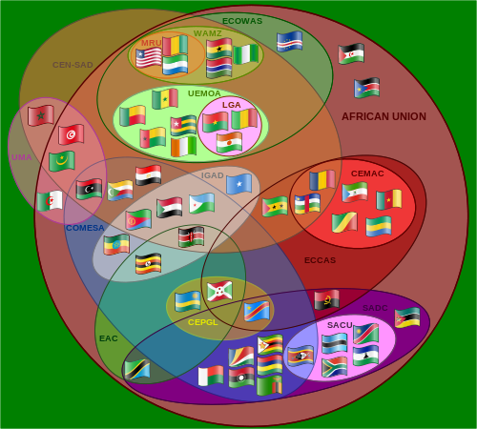
African Trade Blocs

Slide 22
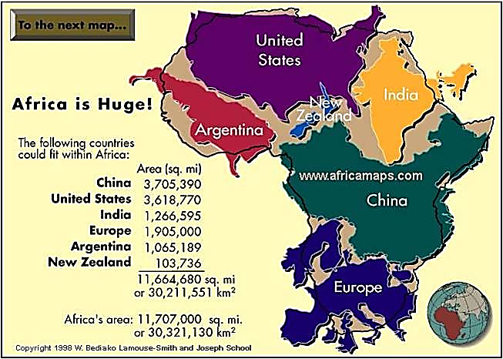
Size of Africa

Slide 23
EXPORT ACTIVITIES

Slide 24
EXPORT DEVELOPMENT
TIKZN Enterprise Development Program
4 x groups of 6 companies to be developed
Training to be supplemented with onsite mentorship
2. PUM Mentorship Program
Experts from Netherlands will be deployed for 3 week at a time to consult to KZN Companies.
2 x groups of 8 companies will be afforded participation into this program
3. CBI Mentorship Program
Netherlands based export capacity building program, tailored for the SA environment.
4. Export Training in Collaboration with Department of Agriculture
2 x groups of 20 companies to be trained

Slide 25
EXPORT DEVELOPMENT
5. Export Training in Collaboration with SIPPO (Swiss Import Promotion Organisation)
50 companies to be trained
6. Export Training in Collaboration with JETRO
50 companies to be trained
7. Master Class
2 x groups of 8 companies to be trained
Training and high level management coaching

Slide 26
EXPORT PROMOTION ACTIVITIES
High GDP Growth Economies
BRICS – Brazil, Russia, China and India
SADC and Africa – Zambia, Mozambique, Zimbabwe, DRC, Botswana, Angola, Kenya, Algeria ….
Middle East and Asia – Saudi Arabia, Kuwait, United Arab Emirates, Indonesia, Malaysia..
Traditional Markets – USA, UK, Japan ….

Slide 27
Trade Promotion Platforms 2014 - 2015
Type | Name of Event | Destination | Date
Local Exhibitions | Source Africa, Cape Town | Cape Town | 06-08 May 2014
 | SAITEX | Johannesburg | 22-24 June 2014
 | SA Automotive Week | Johannesburg | 13-17 Oct 2014
 | Decorex - JHB | Johannesburg | 6-10 August 2014
International Trade Initiatives | ITI Brazil | Brazil | 01 October 2014
 | ITI China | China | 08-11 September 2014
 | ITI India | India | 14-27 September 2014
National Pavillions | FILDA (Feira Internacional da Luanda), Angola | Angola | 15-20 July 2014
 | Interpolitex Russia | Russia | 28-31 October 2014
 | Zambian International Trade Fair (Ndola, Zambia) | Zambia | 25 June – 01 July 2014
 | Foodex Japan 2015 (Tokyo, Japan) | Japan | 3 - 6 March 2015
Outward Selling Missions | Indonesia (Consideration of proposal from SA Embassy) | Indonessia | 01 September 2014
 | DRC (Follow up visit with office of the Premier) | DRC | 01 August 2014
 | Swaziland International Trade Fair 2014 (E3R) | Swaziland | 01 September 2014
 | FoodAgro | Kenya | 03-05 October 2014
 | West & Central Africa Mining Expo (WaCA), Ghana | Ghana | 17-19 September 2014
Inward Buying Missions | Kuwait/UK | Durban | 09 February 2015
 | Ghana Follow-up | Ghana | 01 April 2014
 | DRC/USA | Durban | 14 November 2014
Trade Missions (SSAS) | Promote 2014 | Cameroon | 14 December 2014
 | Euro Satorie France | France | 16-20 June 2014
 | Botswana Global Expo | Botswana | 01 November 2014
 | NY Now | USA | 16-20 August 2014
 | India Engineering Sourcing Show | India
 | Import Shop Berlin | Germany | 12-16 November 2014
Export Scoping Missions | World Future Energy Summit (WFES) 2015 (Abu Dhabi, UAE) | United Arab Emirates | 16 - 19 Jan 2015
 | Tanzania /Kenya International Trade Fair | Tanzania | 01-05 January 2015

Slide 28
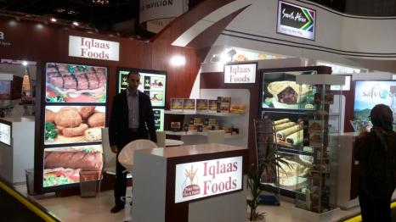
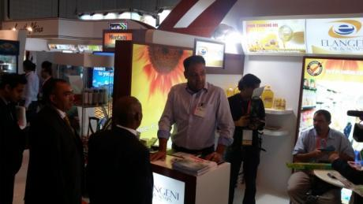
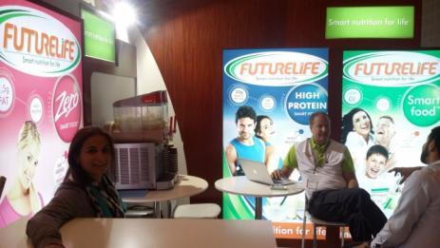
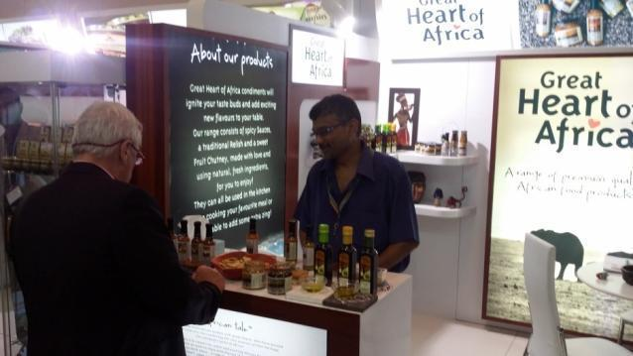
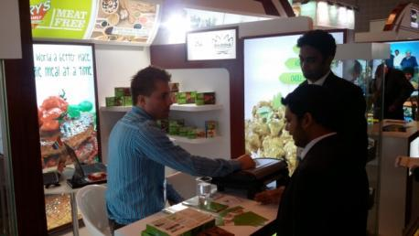
Gulfood 2014

Slide 29
Strategic Projects
1. Export Directory
2. Export Information Portal
3. Accredited Enterprise Development Program
4. Smart Apps Development

Slide 30
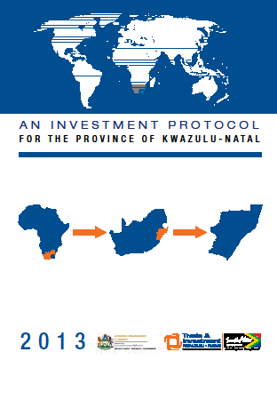
TIKZN TOOLS

Slide 32
Contact Details
Physical address:
32 Kingsmead Boulevard
Kingsmead Office Park, Durban, 4001
Postal address:
PO Box 4245, Durban 4000
Telephone: + 27 (0) 31 368 9600
Fax: + 27 (0) 31 368 5888
Email: info@tikzn.co.za
Website: www.tikzn.co.za
Physical address:
99 George Storrar Avenue
Groenkloof, Pretoria, 0181
Postal address:
99 George Storrar Avenue
Groenkloof, Pretoria, 0181
Telephone:
+ 27 (0) 12 346 4386
Fax: + 27 (0) 86 501 0848
Email: info@tikzn.co.za
Website: www.tikzn.co.za

