Slide 1
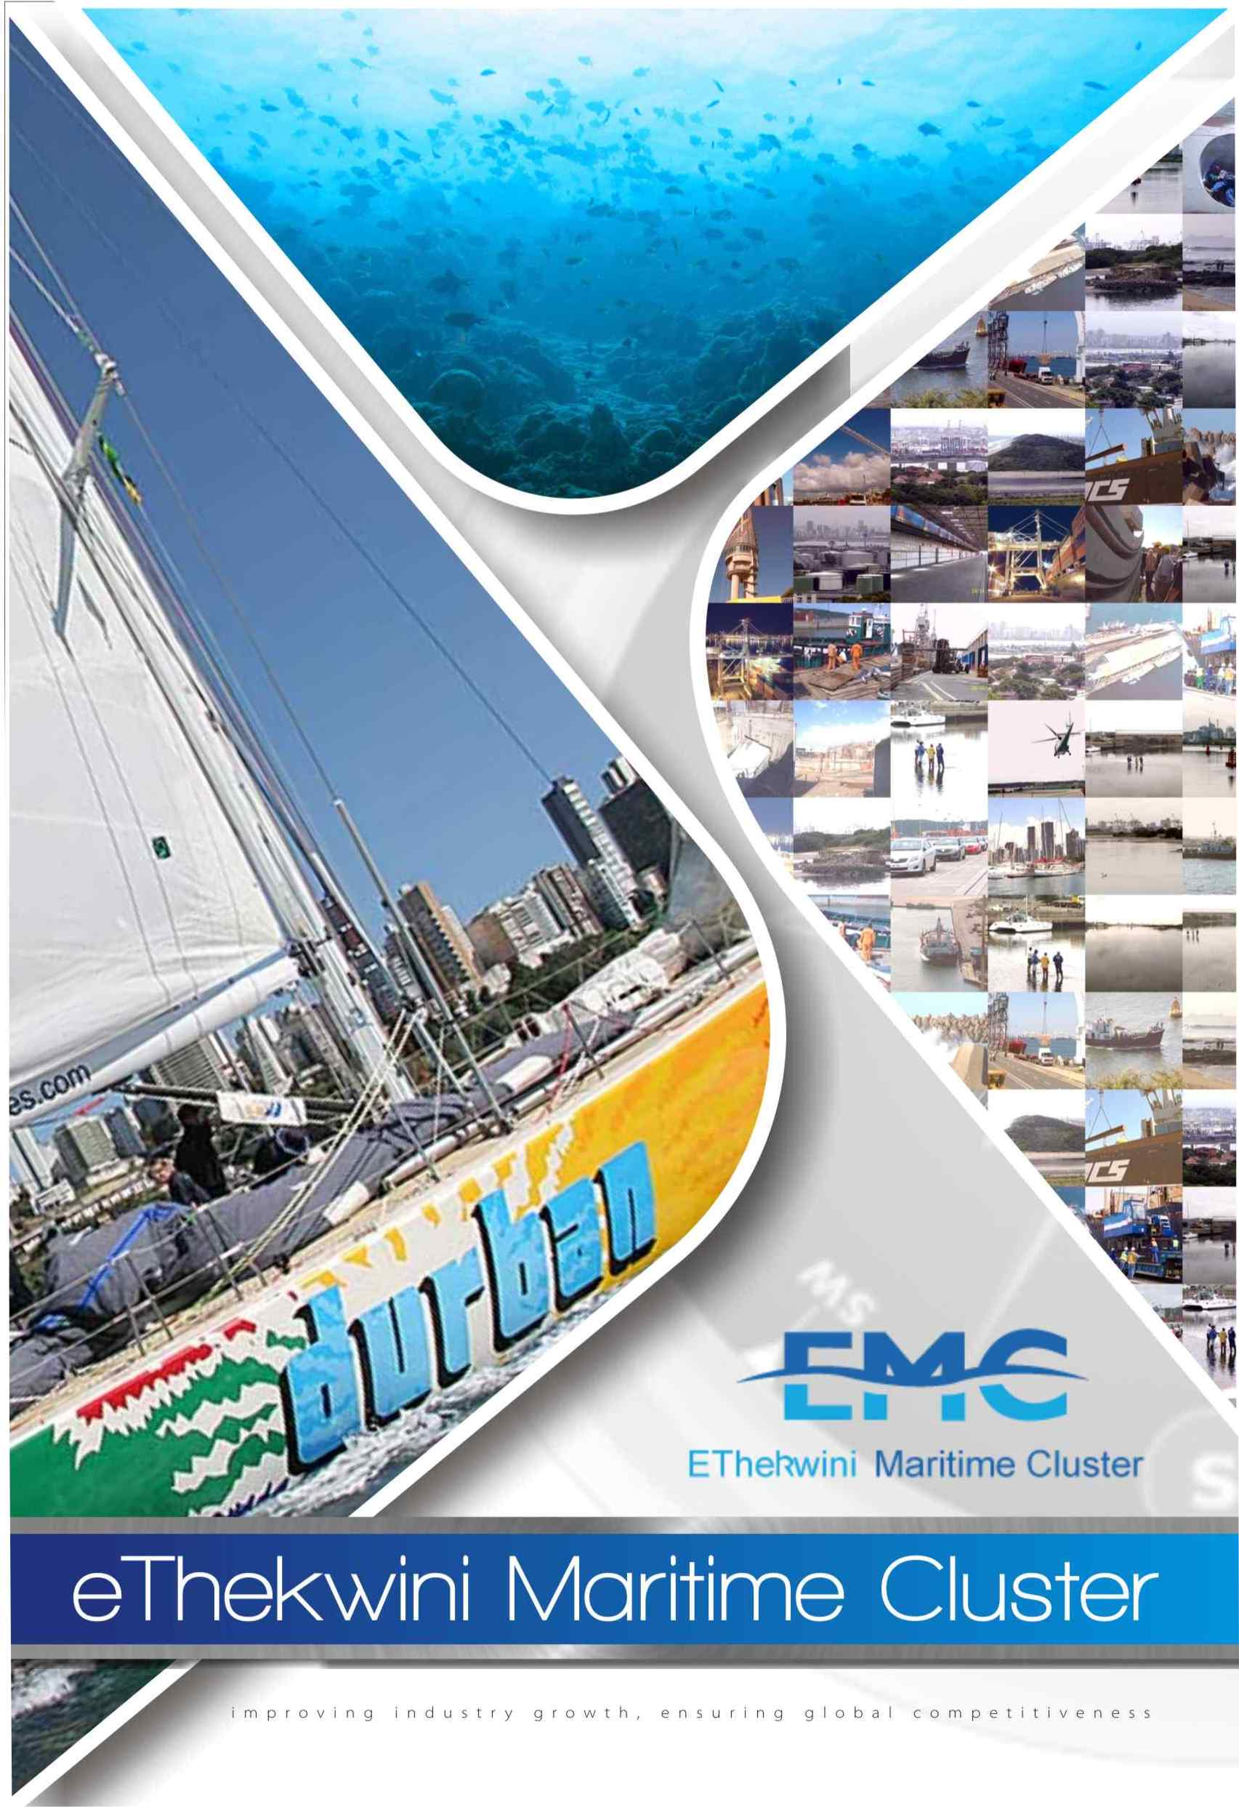

Slide 2
Ship Repair Overview Mr Rob Deane: SA Association of Shipbuilders and Ship Repairers
Overview of the Ship Repair Sector
Supply Chain of the sector
Advantages of operating in Durban vs elsewhere in South Africa
Issues / gaps / challenges of the Durban operating environment
Recommended interventions

Slide 3
History of Ship Repair Industry
The ship repair industry is as old as the port itself. Two Repairers have a history of more than 100 years in the Port.
The industry is directly linked to the activities of the port and tends to be very volatile at times, resulting in extremely active times followed by depressed times.
E.g. closure of the Suez Canal in the 60’s - huge increase in activity in the ship repair activities in Durban.
Current world financial crisis that started in 2008 which resulted in a collapse in charter rates for vessels which in turn caused a severe downturn in the repair market.

Slide 4
FACILITIES and INFRASTRUCTURE
TNPA Operated Facilities:
Graving Dock – 325,0m Long x 33,52m Wide
Floating Dock- 109m Long x 22m x 4 500 ton Capacity
Repair Quays – Several, Longest is 220m each side
230 tonne Floating Crane
Privately Operated Facilities:
Repair Quays of 220m; 200m; 160m; and 110m
Repair Infrastructure including Cranes; 4x Slipways; Load-out Areas; 120 tonne Floating Crane; Specialised Repair Equipment; Workshops and Machine Shop
Electrical and Hydraulic Repair Facilities

Slide 5
Bayhead Ship Repair Facilities 1
DORMAC
EBH
SubTech
SA Shipyards

Slide 6
Bayhead Ship Repair Facilities 2

Slide 7
TNPA Graving and Floating Docks

Slide 8
Industrial Involvement
Direct Participation:
Marine Engineering and Design Services; Naval architecture; Welding and Cutting Gasses and Consumables; Paints and Chemicals; Steel Plates and Profiles; Pipes, Valves, Flanges and Pipe fittings, Insulation Materials; Surface Preparation Materials; Wire Ropes and Rigging Materials; Fuels Oils and Lubricants; Machining, Assembly and Test; Inspection Services; Metrology; Specialized lifting and handling equipment; Sampling & Chemical Analysis; Fuels, Lubricants and Solvents; to name but a few.

Slide 9
Industrial Participation
Peripheral Participation:
Trade Training and education, Skilling; Labour supply; Transport and Accommodation; Protective Clothing and Footwear; Health and Security Services; Ship Handling, Mooring, Berthing and Docking Services; Ship Chandelling and Agency Services; Accounting Services; Customs and Excise Services; Procurement and Contracting; Legal and Consultancy Services; Photography; Printing Copying and Reproduction; etc. etc.

Slide 10
THE MARKET /COMPETITION 1:
Durban is the busiest port in Southern Africa handling some 3 000 000 TEU’s per annum. 3 500 vessels visit the port each year. It is from the port activities that the majority of the ship repair results.
CARGO VESSELS
These vessels may have the opportunity to repair/dock in Durban, depending on their cargo commitments. They may also have the same opportunity at the other end of their destination.
For this reason the cost of repairing in Durban has to be internationally competitive. These vessels will only deviate from their normal route when there is no other choice. The costs when deviating in fuel, operating costs and loss of charter are high.
Example: Supply / Large tugs @ $50 000/day charter rate.

Slide 11
THE MARKET / COMPETITION 2:
VESSELS OPERATING IN THE PORT
Tugs, launches, pilot vessels, barges, dredgers. These vessels will repair/dock in their ports of operation if at all possible.
VESSELS COMING TO THE PORT SPECIFICALLY FOR REPAIRS/DOCKINGS
Vessels in this category would normally try to repair / dock in the nearest port to their area of operation. These would include fishing vessels, offshore supply and service vessels, specialized vessels (research, cable laying, dredgers etc.)

Slide 12
THE MARKET /COMPETITION 3:
EMERGENCY SITUATIONS
Vessels which have an emergency situation will make for, or be towed to the closest suitable port (Collision, grounding, fire, engine failure etc.).
PASSING VESSELS
These could take the opportunity should they be in ballast or relocating to repair/dock.

Slide 13
THE MARKET /COMPETITION 4:
In Durban more than 85% of all ship repair work carried out is for international ship owners and as such, it is a highly competitive industry internationally.
In SA the ship repair industry costs are all SA Rand based. 85% of the work done on the basis of a USD quote and payment in USD. Between 2003 to 2011 to R/$ exchange rate has varied between R 5,50 – R13/$. As you can imagine this is an extremely difficult situation to manage, due to the facts previously noted in respect of the market together with the exchange rate.

Slide 14
The Economic Value of Ship Repair to the Port and the Country
The ship repair industry is very labour intensive, ranging from unskilled to highly skilled workers. The industry employs a large number of people.
On a number of studies done on the industry it has been established that through the backward and forward linkages, the multiplier effect from ship repair is between 4 and 7 (i.e.. for every direct job there are between 4 and 7 direct jobs created)
The value of the ship repair industry varies considerably from year to year. At full capacity it is estimated that the value of ship repairs undertaken in Durban by all the players would be in the order of R1.5 Billion
As employees make up the single largest cost in the industry estimated at approximately 25% of the cost of sales – this would relate to some 2 000 – 3 000 people directly employed and with the multiplier effect + 12 000 people. The industry is therefore an important and significant contributor for the city and the country

Slide 15
Critical Challenges 1
Most of the key facilities used by ship repairers are owned and operated by the TNPA. For the TNPA this is not their core business and it does not generate sufficient funds for these operations (Docks, quays, repair facilities) to justify proper maintenance yet alone modernizing and upgrading.
Generally the condition of the Dock Facilities are poor and outdated. The TNPA floating dock has been out of operation for more than two years!
The rates levied for these services are amongst the highest in the world. Ongoing increase in electricity charges further aggravates the many difficulties for the local ship repairers in being internationally competitive in respect of cost and time.

Slide 16
Critical Challenges 2
In the vast majority of ship repair industries around the world, the ship repairers operate and own the facilities (docks). This structure misalignment in respect of the TNPA facilities and the ship repairers has resulted in a serious barrier to the industry meeting its potential.
The Docks when operated on their own without ship repairs as part of the entity cannot generate sufficient funds to justify the expenditure necessary to upgrade and operate these on a world class basis. This problem has been recognized by both the TNPA and the ship industry and efforts are being made to improve the current situation.

Slide 17
Critical Challenges 3
A further barrier has been the lack of finality on future port expansions. Some of the proposals in the recent past have indicated that most of the ship repair area would be lost to cargo operations.
As a result any private initiatives to put in additional facilities were not considered feasible due to the potential lack of tenure. Also TNPA were reluctant to allow any development until clarity on the final Port layout
The latest proposal to start the major port expansion at the old airport site will to some extent ease this situation, as it would guarantee tenure to the ship repair industry and also allow TNPA to make decisions for the possible expansion and placing of new facilities by industry.

Slide 18
Critical Challenges 4
There are of course many other critical challenges such as skills shortage however; these are being progressively dealt with by the industry, in particular, training and skilling of employees and management.
Currently the world economy is in turmoil; an uncertainty which is creating many problems for the industry.
The ship repair industry is largely US Dollar based i.e. Most repair quotations are USD and have to be competitive internationally and the recent strength of the Rand has caused difficulties for the local industry to meet budgets.

Slide 19
Opportunities for the Industry
MARKET
Hopefully the world economy will stabilize and allow some increase in volumes resulting in increases in ship repair activity.
It is anticipated that the oil and gas exploration currently being undertaken on the East Coast will result in the establishment of a large oil and gas industry which the ship repairers will service. On the West Coast this has resulted in substantial work for the oil and gas and ship repair industry all along the West Coast, including Cape Town, Saldana Bay and Walvis Bay. Over the medium to long term this has huge potential for Durban (See Next Slide).

Slide 20
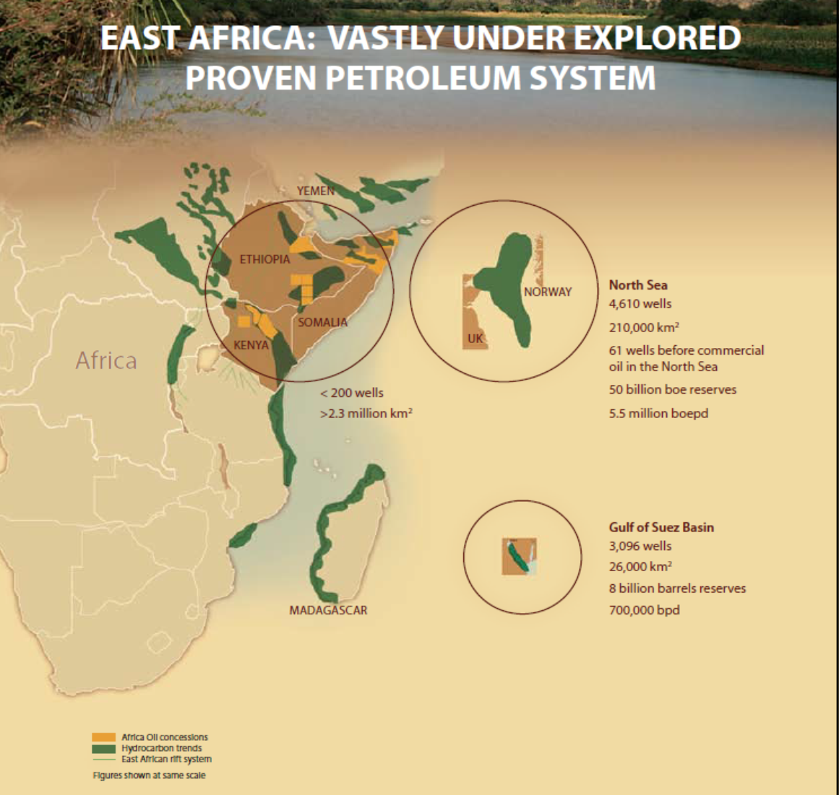

Slide 23
Opportunities for the Industry 2
The proposed expansion of the Port of Durban which will take the current 3 000 000 TEU capacity to in excess of 12 000 000 TEU and in the long term will create enormous opportunities for the repair industry.
In the short term the civil works required to do this expansion (Dredgers/ Barges, etc.) will also create work for the ship repair industry. The previously mentioned full capacity estimate for ship repair was constrained by the lack of dock and quay facilities and up to 2008 / 2009 many vessels requiring dock facilities in Durban had to be turned away; and were docked outside of South Africa.

Slide 24
The Way Forward: 2011-2015
Evaluate all new opportunities and offer Durban and or Richards Bay as an alternative Port for East African Oil Rig Repair.
Solidify strategic industrial and supplier alliances – Find a suitable International Strategic Partner.
Develop dedicated Semi-Sub Rig, FPSO and Drill Ship repair facilities and Dry, Cold and Ready Stacking rig servicing capacity
Develop Propulsion, Mechanical, Electrical and Hydraulic Plant and Equipment core skills – Priority; Rolls Royce & Siemens Marine
Develop Container / Cargo, LNG Vessel Repair market as Port Repair is increased and Port is dredged to -16m CD.
Diversify the Ship Repair business model into Conversion, FPSO’s, Power Barges; and Open Sea Mining – as an additional source of Ship Repair revenue

Slide 25
Recommended Interventions
Should the current facilities not be expanded, obviously this potential new market will be serviced elsewhere.
Over the next twenty years should the right conditions for ship repair be timeously developed, the Durban-based industry could easily treble in size with the resultant benefits to the city, our country, employment, training, etc.
Immediate:
Stabilise the Port Development Plans which impact on the Ship Repair Facilities so that Industry knows where it stands
Realise the TNPA Ship Repair Assets so that they can be upgraded to World Class Standards (an initiative is currently in progress)
Consider a reduction in TNPA Port Charges to Ship Repair Industry.

Slide 26
Recommended Interventions 2:
5-Year Plan:
New Dry Dock/ Floating Docks facilities to cope with anticipated ship repair volumes and types of offshore vessels (Broader Beam and Deeper Draught, Thrusters)
Establish Maritime Trade Training Schools to skill our young workers and educate them technically to International Standards
Progressive:
Allocate more quay space to Ship Repair and the Offshore Industry for repair and conversion berths as the New Port develops

Slide 27
End of Ship Repair Presentation
Thank you for listening so attentively

