Slide 1
OLD MUTUAL AGENCY FRANCHISE DIVISION
27 March 2014
BY: Nkosikhona Mbatha
Provincial Manager:KZN

Slide 2
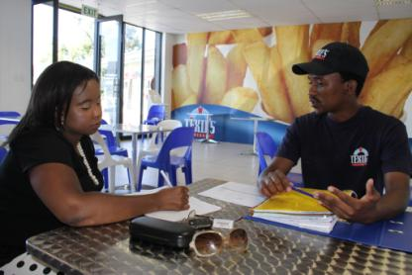
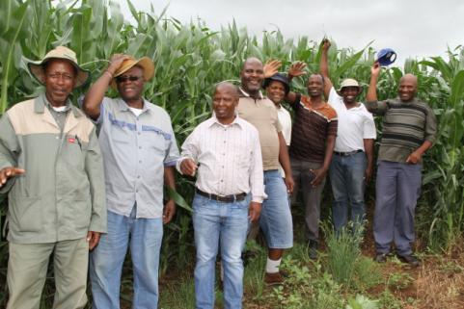
WHAT WE DO
Enterprise Finance
Development & Support
Positively impact communities and facilitate job creation in SA

Slide 3
HOW DID IT START?
The Masisizane Fund is an initiative of Old Mutual established in 2007 following the closure of the Unclaimed Share Schemes Trust and in consultation with the National Treasury of South Africa.
Masisizane was set up as a non-profit funding company to provide loan financing and support to SMME’s.

Slide 4
MANDATE
Employment creation, poverty eradication and reduction of inequality.
Contribution to economic growth.
Bias towards women, youth and disabled.
Focus on economically under-developed areas: rural, townships and peri-urban areas.

Slide 5
BOARD OF DIRECTORS
BM Rapyia (Chairman)
SH Somdyala (Chief Executive Officer)
GM Ackerman
PJ Golesworthy
R Kisten
F Robertson
GT Serobe
L Phalatse
M Manjezi

Slide 6
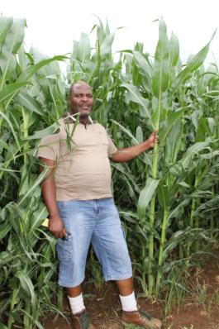
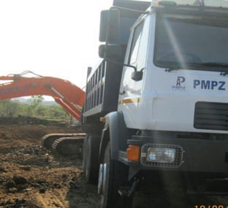
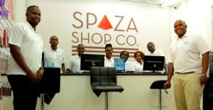
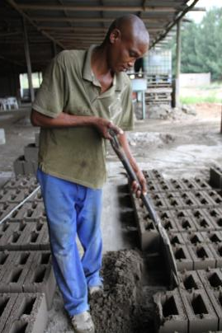
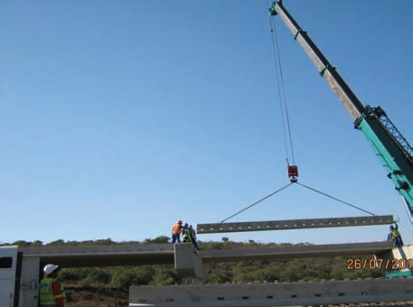
WHAT WE FUND
Agriculture | Manufacturing | Retail Services | Supply Chain Dev

Slide 7
OFFERINGS
Agriculture
Grain and vegetable crops
Livestock - breeding and sale
Implements and equipment
Manufacturing
Working Capital
Equipment
Retail Financing/Franchising
Working Capital
Equipment
Supply Chain Development
Contract finance – revolving contract financing

Slide 8
OFFERING INCLUDES
Pricing varies between prime -5% and +5%
Supply chain finance can go up to +8%
Pricing is informed by rate of recovery
Risk mitigations
Seasonal or cyclical reviews
Off take agreements
Crop insurance
Asset insurance
Cession of contract

Slide 9
DISBURSEMENTS
R76.2m end of 2013
124 active loans
1 746 job opportunities fluctuating between seasons
Impairments on the new book (2012 to 2013) were at 25%

Slide 10
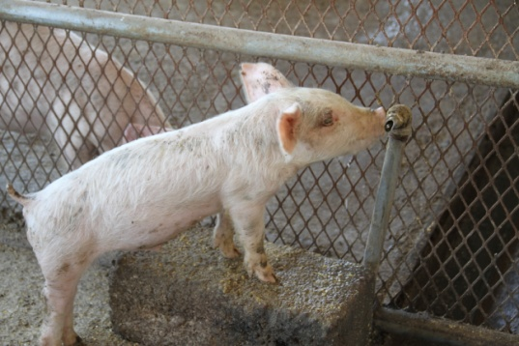
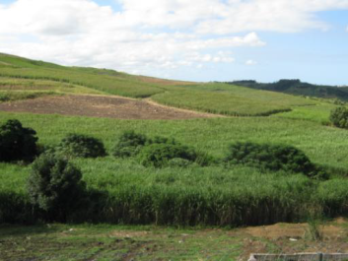
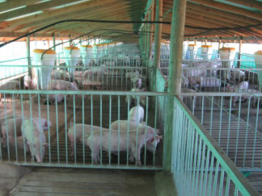
PRIMARY AGRICULTURE
Simba Mabhele Farm in Margate started in 1998. This is a 46 ha mixed farming unit that was privately bought by Mrs Mbalo.
Mrs Mbalo resigned from her professional nursing career in 1997 to pursue full-time farming on behalf of the family.
Current activities include 40 sow piggery unit with the latest feeding and rearing technology, a 2000 broiler unit with abattoir, as well as a 25 ha suger cane.
With a loan from Masisizane the business is constructing a 100 sow unit.
Simba Mabhele supplies two abattoirs in Camperdown (SALA) and Bayensfield.
The enterprise is part of the Masisizane Fund piggery cluster earmarked for the KZN South Coast Region

Slide 11
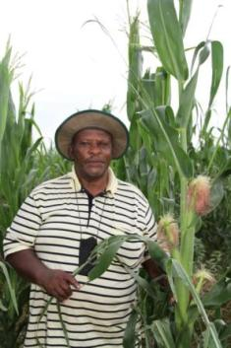
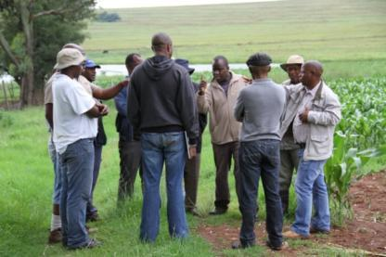
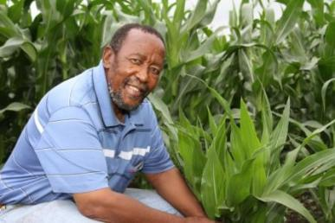
MATATIELE MAIZE CLUSTER
ONE CLUSTER
IN ONE DISTRICT
MATATIELE
15 SELECTED FARMERS
MAIZE PRODUCTION
R9.8m approved for cluster
1010 hectares land
Mentorship provided
Cluster provides learning platform mentoring one another
Strong negotiating power
70% success rate in first season
E Mohapi
Chairman of the Group

Slide 12
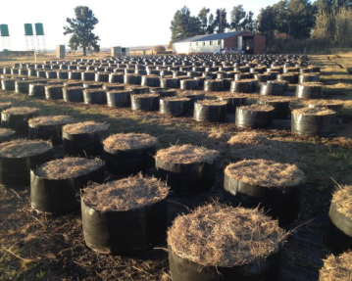
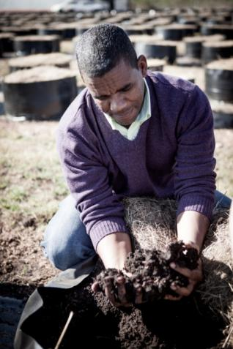
SUPPLY CHAIN (Agri-Value Adding)
Letlatlana Primary Co-operative forms part of a turnkey business operation in the production of vermicast using earthworms that produce organic fertiliser.
There are 8 members in this co-op that hails from the reclaimed land belonging to the Bakubung tribe in the Boons area of North West.
Employing an extra 8 part time workers.
Masisizane Fund provided loan finance to Letlatlana to start up the earthworm fertiliser business.
Secured markets with Vermi Trade supplying to local and international markets.
Letlatlana co-op is part of the Masisizane Fund initiative of creating agri-clusters in rural South Africa, plugging local economic leakages.

Slide 13
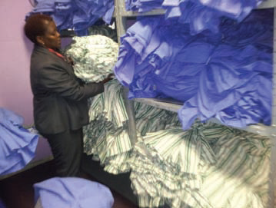
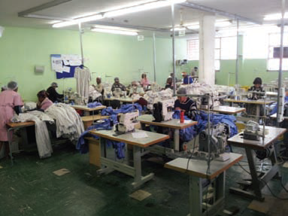
MANUFACTURING
CTU’s Manufacturing Co-operative was established in 2008 by three women Nonhlanhla Mphachoe, Nontokozo Ngcobo and Busisiwe Bhengu in Gauteng.
Manufacturing fully guaranteed products: hospital linen; apparel/attire; uniforms; corporate and personal protective clothing.
Nonhlanhla and Busisiwe were professional nurses who saw an opportunity to supply hospitals with apparel. They resigned and went for business training to turn their idea into reality.
The business has created 56 employment opportunities for disadvantaged women in Gauteng.
In 2013, CTU received loan funding from Masisizane to ensure their fulfilment of contracts with the Gauteng Department of Health.

Slide 14
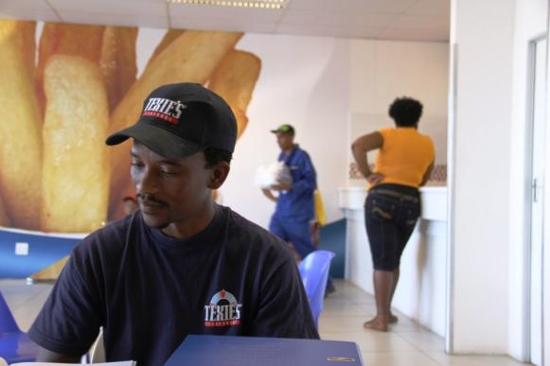
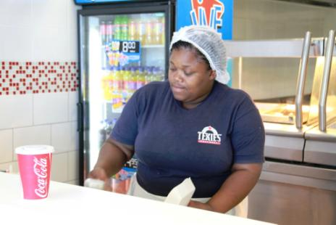
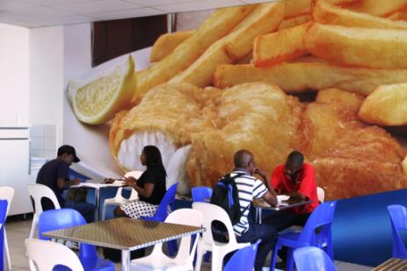
BLACK SUNSHINE GROUP t/a TEXIES FISH & CHIPS - Franchising
Texies Fish & Chips franchise in Phillipi
Young male opened shop in his community
Employs five people
Experiencing challenges with landlords and security/break-ins/armed robbery
Still talking about opening another shop in two years time

Slide 15
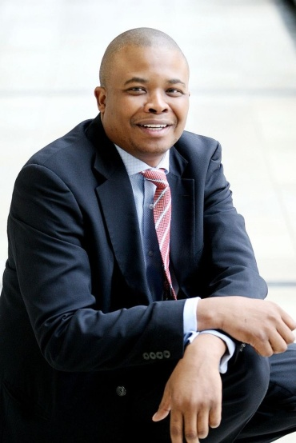
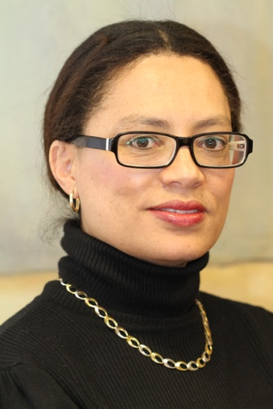
EXECUTIVE COMMITTEE
Simpiwe Somdyala
Chief Executive Officer
Lynette Bell
Chief Financial Officer
Tumi Sefolo
Head: Enterprise Finance and Development

Slide 16
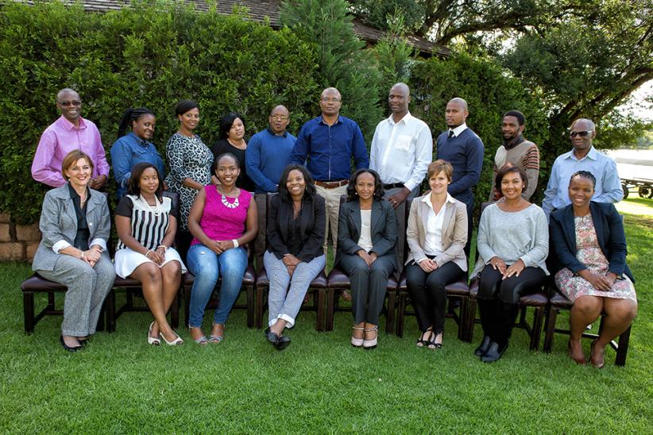
MASISIZANE TEAM
Kwa-Zulu Natal 21st Floor, Old Mutual Centre 303 West Street, Durban Tel: 031 302 5414 Email: Nmbatha@oldmutual.com Eastern Cape 1st Floor, The Towers, Vincent Park Devereux Avenue, East London Gauteng, North West & Free State 2nd Floor, Isibaya Building, Old Mutual Square, 93 Grayston Drive, Sandton Limpopo & Mpumalanga 5th Floor, Old Mutual Building, 70 Hans van Rensburg Street, Polokwane Western Cape & Northern Cape 2nd Floor, Mutualpark, Jan Smuts Drive Pinelands

Slide 17
THANK YOU

